Slide 1
Forecasting Solar Energy Adoption in the state of New York: A Machine Learning Approach
Paul John Thomas, Ratnapal Gandhi, Sneha B. S., Guttha Vimala, Vishnu Prasad Ranjith

Slide 2
Predict Solar Energy Adoption Rate in the state of New York

Slide 3
Problem Statement

Slide 4
Forecast the expected annual energy production (kWh) for new solar projects in the State of New York
NY State has ambitious goals for renewable energy adoption
This project aims to develop an ML model capable of predicting future solar energy adoption rates in the state of New York

Slide 5
Business Understanding

Slide 6
The state of New York is shifting towards a distributed energy system
Goal: 70% of electricity generation to come from renewables by 2030
Goal: achieve a fully renewable-resources-powered grid by 2040
Goal: bolster grid resilience and air quality
Goal: reduce dependence on centralized power generation
How: powered by a diverse mix of renewable resources
Why: mitigate impacts of extreme weather events and cyber threats
Why: prioritize equity (address disparities in community resilience and access to clean energy)
NY State Energy Research and Development Authority (NYSERDA) is advancing smart grid technologies
Solar energy is a crucial component of the goals above
But, significantly higher adoption rates needed to meet targets

Slide 7
Approach

Slide 8
Utilize time series analysis to forecast the 2024 "Expected kWh Annual Production" based on monthly data from 2002 to 2023
Apply the following to identify the most effective forecasting model:
ARIMA
SARIMA
Simple Exponential Smoothing
Holt's Double Exponential Smoothing
Holt-Winters models

Slide 9
Data Understanding

Slide 10
The NYSERDA dataset contains comprehensive information from Jan. 2000 to Dec. 2023 on solar energy projects in New York State
1) Reporting Period: Period for which the data is reported
2) Project Number: Unique identifier for each project
3) Legacy Project Number: Identifier for legacy projects
6) Street Address: Address of the project site
7) City: City where the project is located
8) County: County where the project is located
9) State: State where the project is located
10) ZIP Code: Postal code of the project's location
11) Incorporated Municipality: Name of the incorporated municipality
12) Municipality Type: e.g., town, city
13) Census Tract: Census tract number
14) Contractor: The name of the contractor responsible for the project
15) Minority or Women Owned Business Enterprise (MWBE): Status of the contractor as an MWBE
16) Latitude: Latitude of the project location
17) Longitude: Longitude of the project location
18) Georeference: Georeference information of the project location
4) NYS Disadvantaged Community Status: Status of the community as disadvantaged
5) Climate and Economic Justice Screening Tool Status: Screening tool status for climate and economic justice

Slide 11
19) Primary Inverter Manufacturer: Manufacturer of the primary inverter
20) Primary Inverter Model Number: Model number of the primary inverter
21) Total Inverter Quantity: Total number of inverters
22) Primary PV Module Manufacturer: Manufacturer of the primary PV modules
23) PV Module Model Number: Model number of the PV modules
24) Total PV Module Quantity: Total number of PV modules
25) Remote Net Metering: Status of remote net metering
26) Community Distributed Generation: Status of community distributed generation
27) Green Jobs Green New York Participant: Participation in the Green Jobs Green New York program

Slide 12
28) Project Cost: Total cost of the project
29) Total NYSERDA Incentive: Total incentive amount received from NYSERDA
30) Affordable Solar Residential Adder: Additional incentive for affordable residential solar projects
31) Affordable Multifamily Housing Incentive: Incentive for affordable multifamily housing projects
32) Community Adder: Additional incentive for community solar projects
33) Inclusive Community Solar Adder: Incentive for inclusive community solar projects
34) Expanded Solar For All Adder: Adder for expanded solar for all initiatives
35) Brownfield/Landfill Adder: Additional incentive for projects on brownfields or landfills
36) Canopy Adder: Additional incentive for canopy projects
37) Prevailing Wage Adder: Additional incentive for projects adhering to prevailing wage requirements

Slide 13
38) Sector: e.g., residential, commercial
39) Program Type: Type of program under which the project was undertaken
40) Solicitation: The specific solicitation under which the project was funded
41) Electric Utility: The electric utility servicing the project
42) Purchase Type: e.g., outright purchase, lease)
43) Date Application Received: Date when the application for the project was received
44) Date Completed: Date when the project was completed
45) Project Status: e.g., completed, in-progress
46) Total Nameplate kW DC: The total nameplate capacity in kilowatts DC
47) Expected KWh Annual Production: The estimated annual energy output from solar installations

Slide 14
Summary of the Dataset

Slide 15
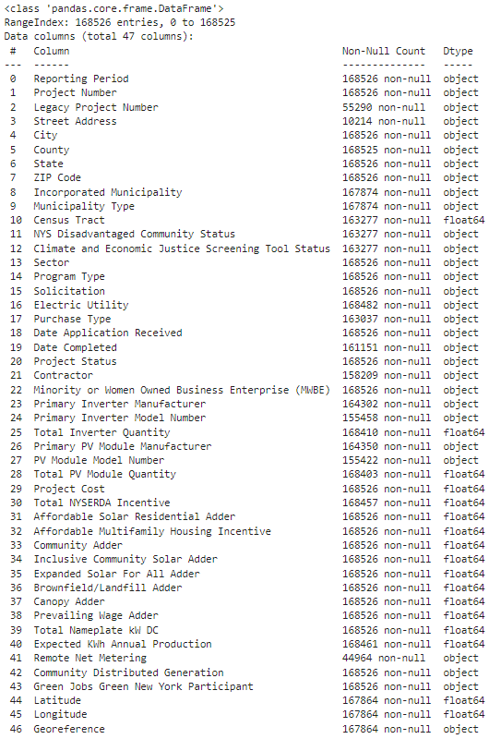
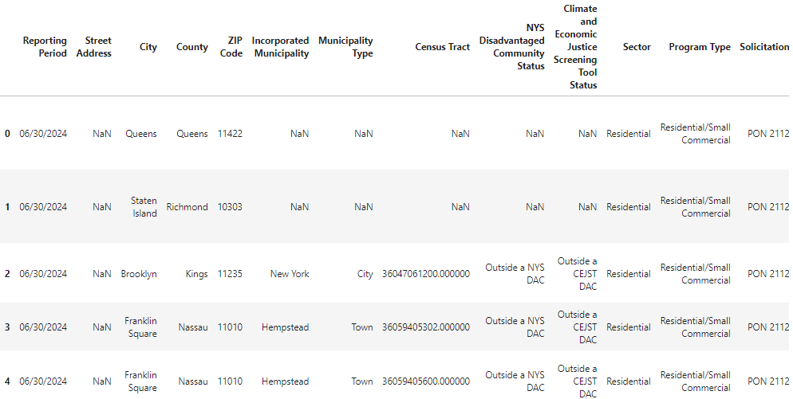

Slide 16
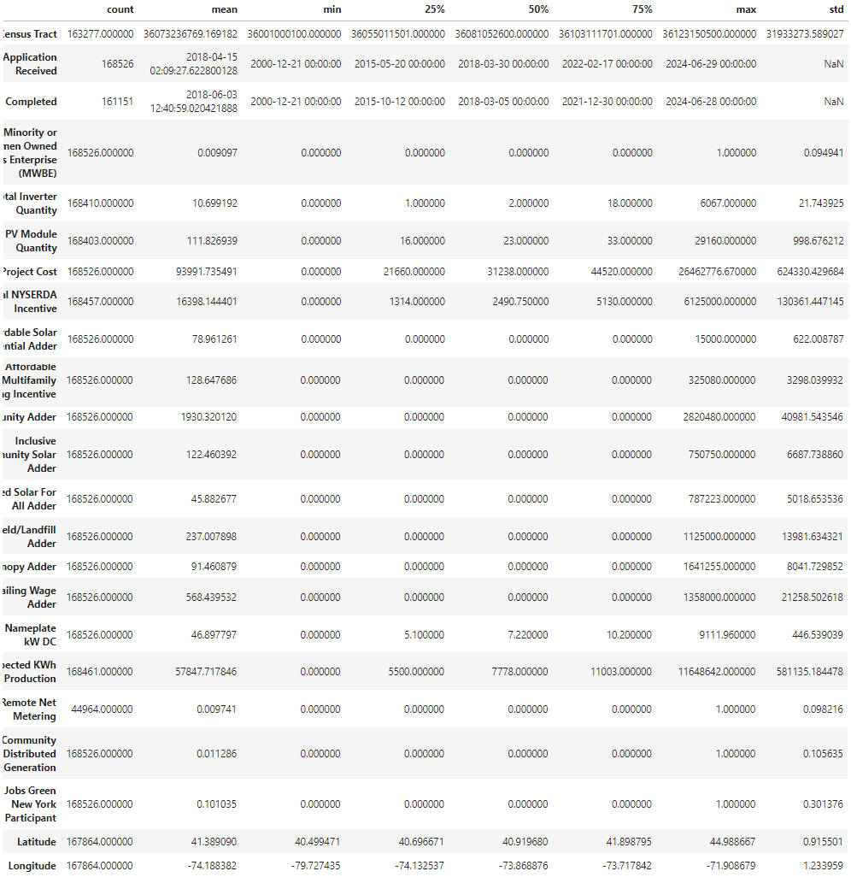
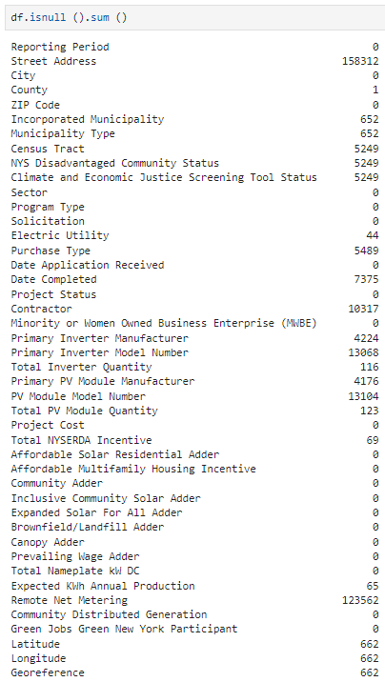

Slide 17
Exploratory Data Analysis

Slide 18
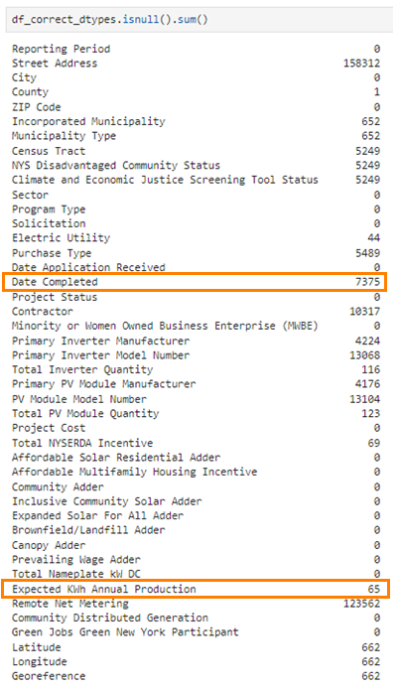
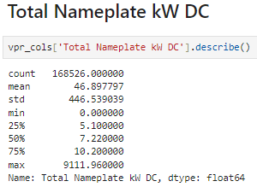
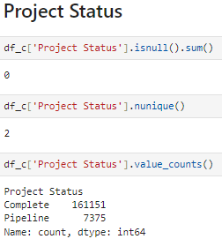
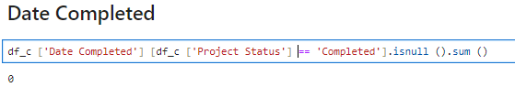
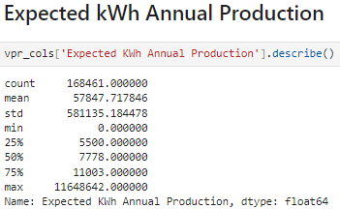

Slide 19
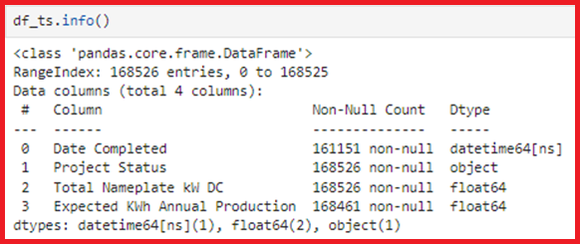
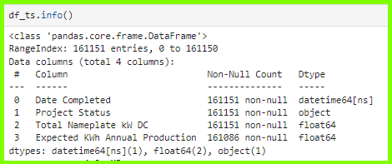
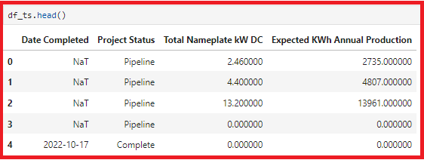
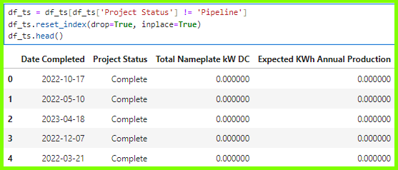
EDA for Time-series
Columns required
Date Completed
Project Status
Total Nameplate kW DC
Expected KWh Annual Production

Slide 20
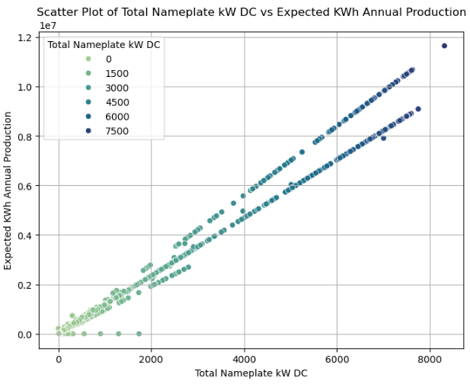
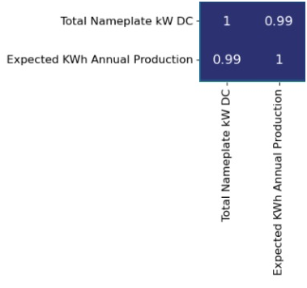
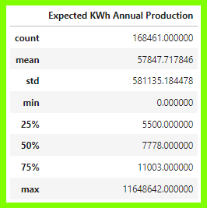
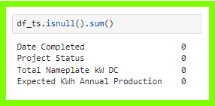
Missing Values Imputation

Slide 21
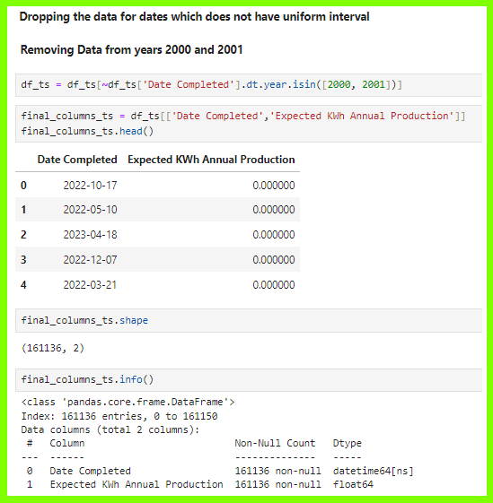
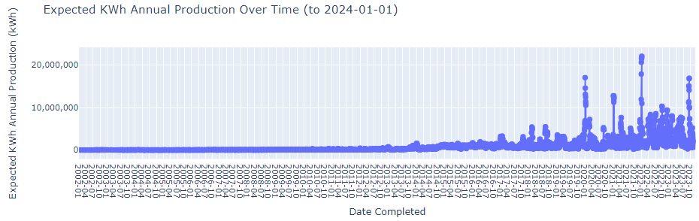
Missing Values Imputation

Slide 22
Data Visualisation

Slide 23
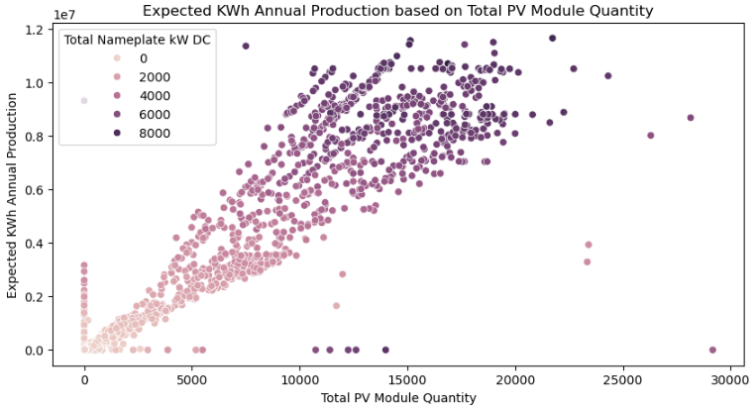
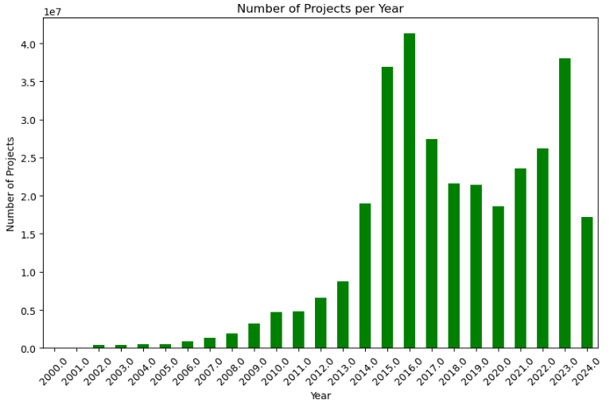

Slide 24
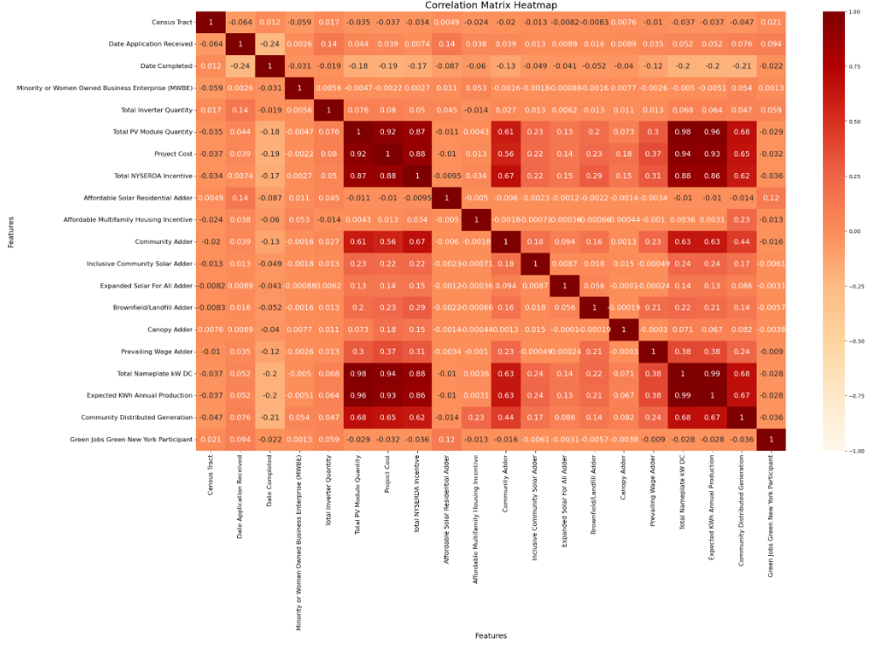

Slide 25
Data Preparation

Slide 26
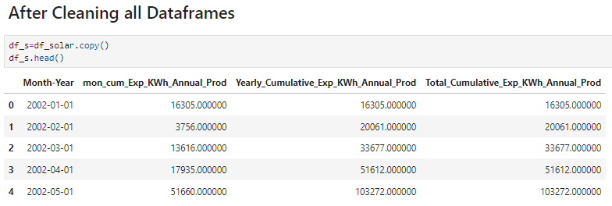
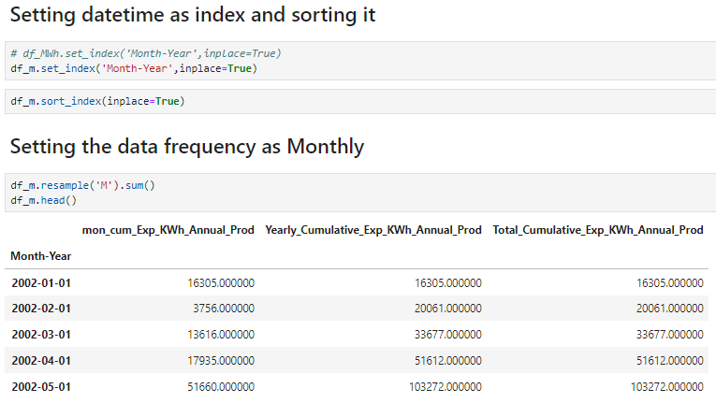

Slide 27
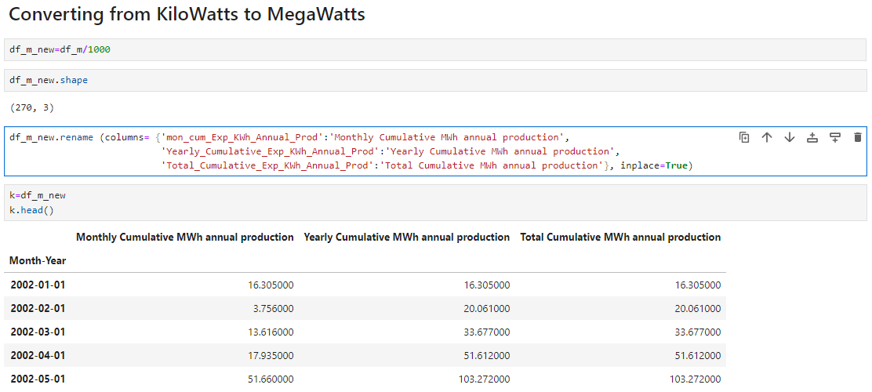

Slide 28
Data Modelling

Slide 29
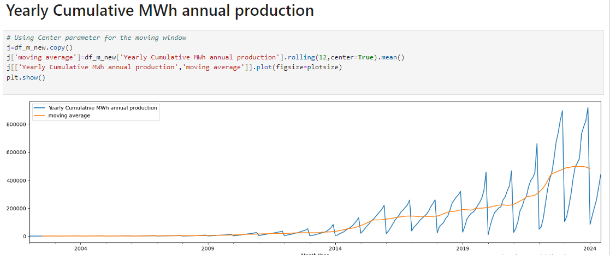

Slide 30
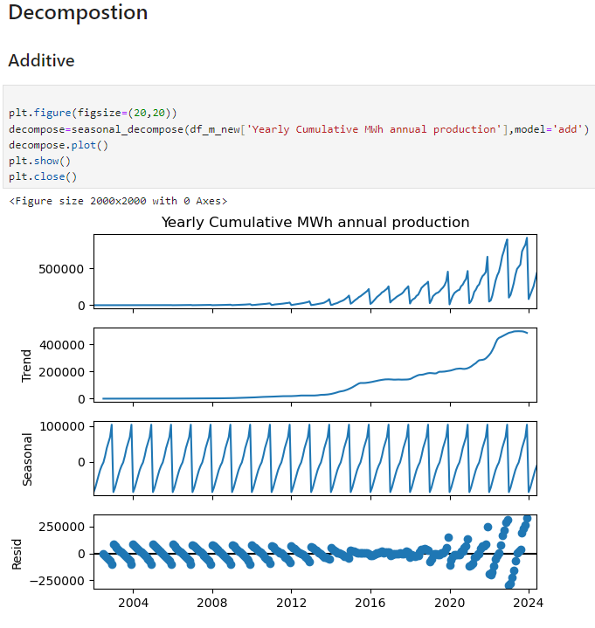
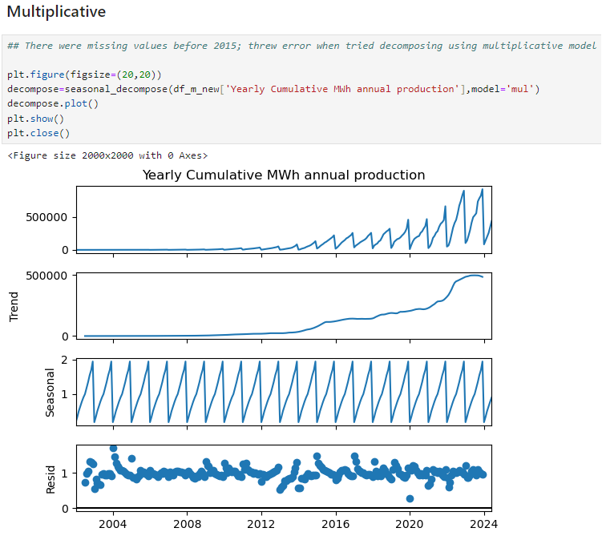

Slide 31
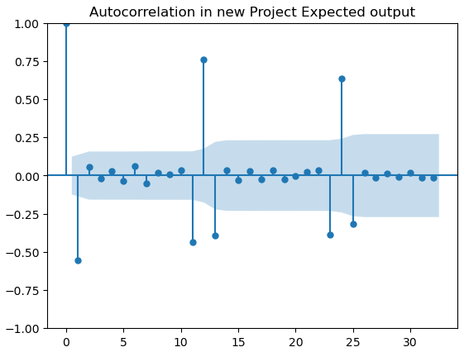
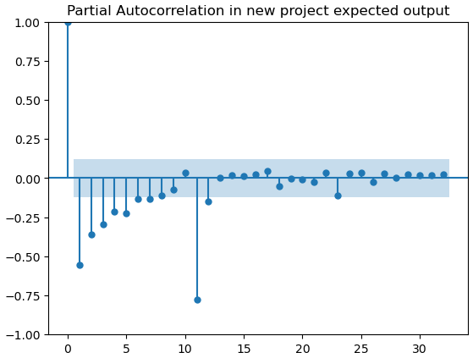

Slide 32
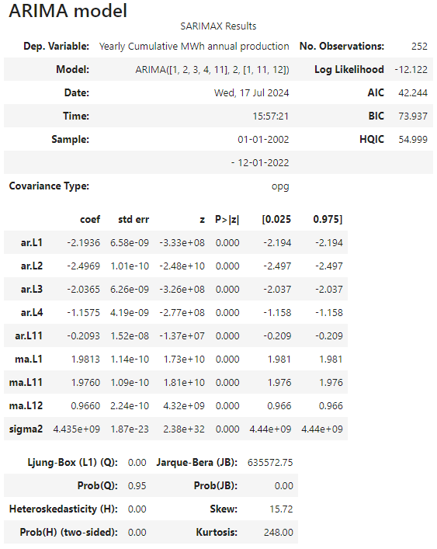
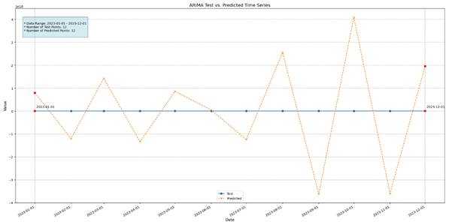
Arima 2002-2023

Slide 33
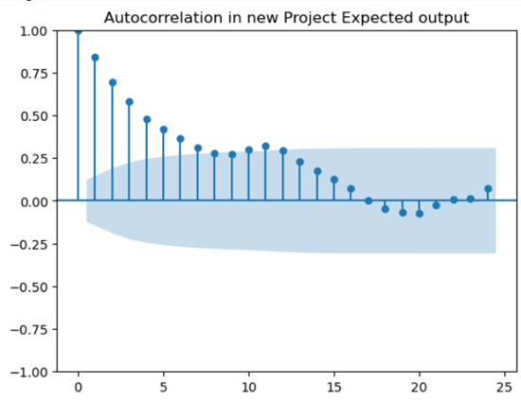
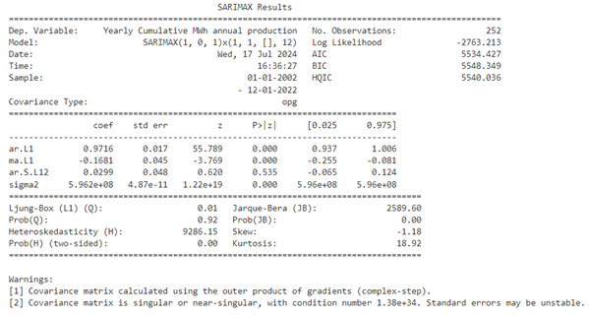
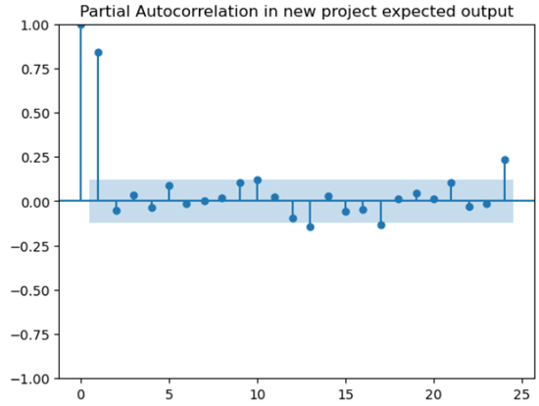
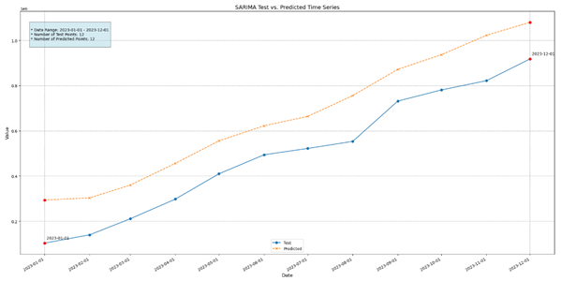
SARIMA 2002-2023

Slide 34
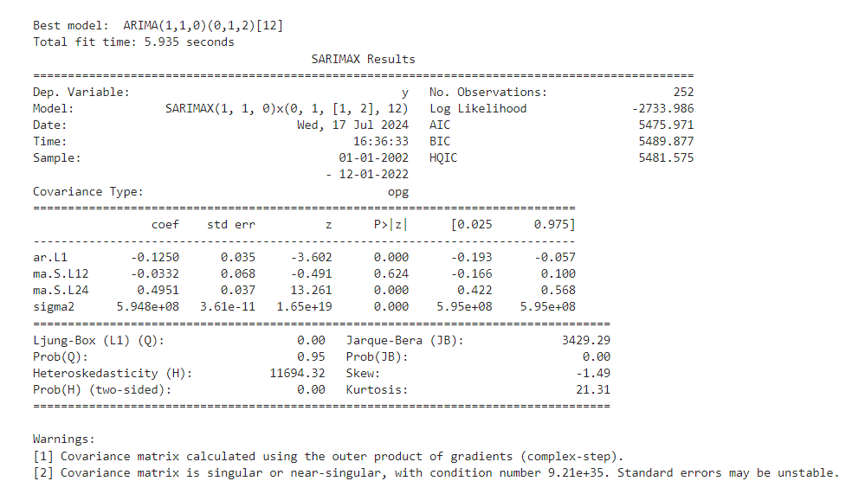
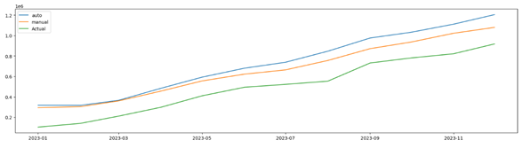
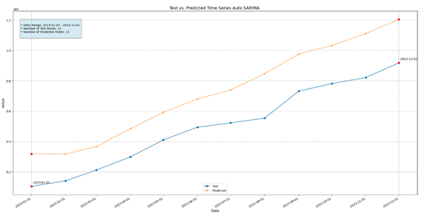
Auto Model Prediction vs Manual Prediction
AUTO SARIMA

Slide 35
Log Transformed Data: 2002-2023

Slide 36
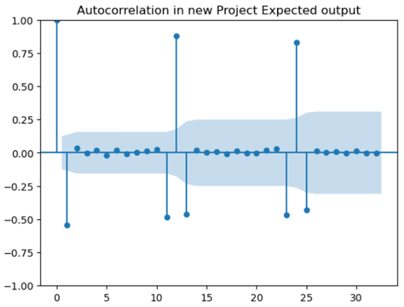
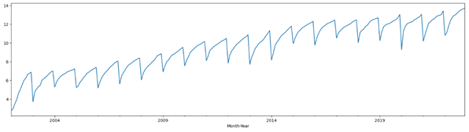
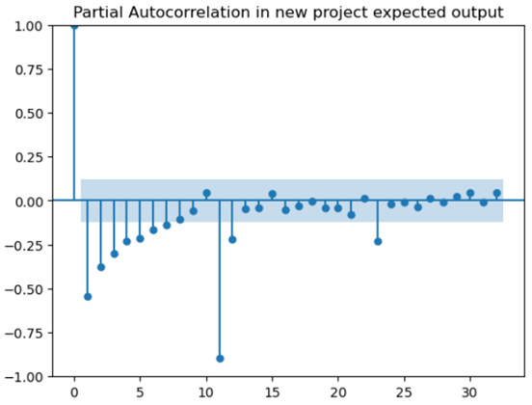

Slide 37
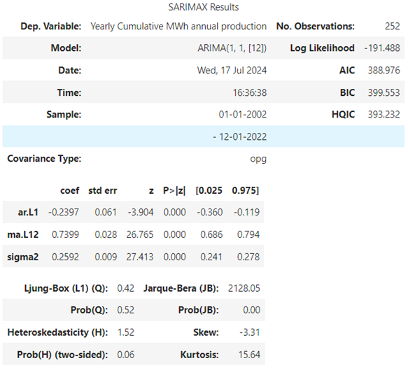
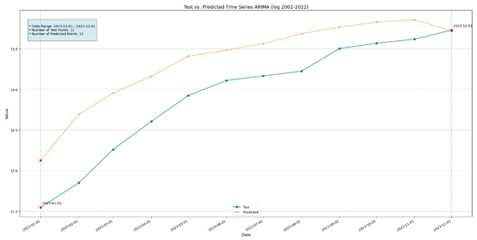
ARIMA

Slide 38
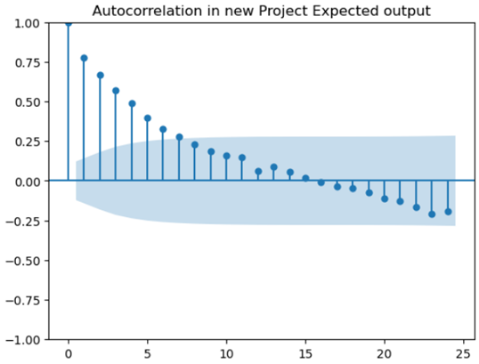
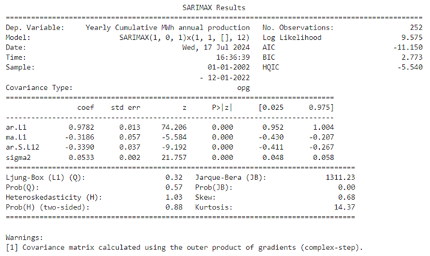
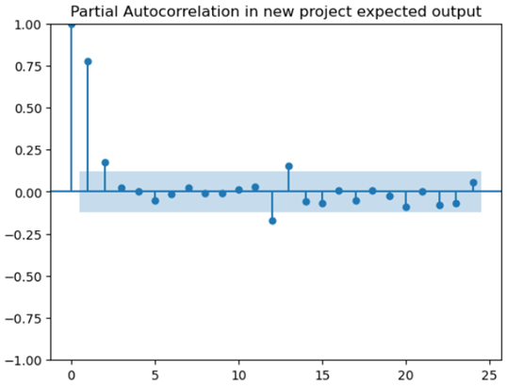
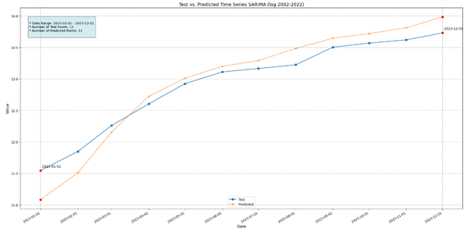
SARIMA

Slide 39
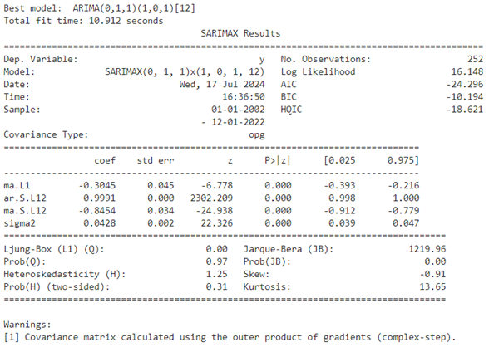
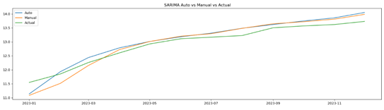

Auto Model Prediction vs Manual Prediction
AUTO SARIMA

Slide 40
Log Transformed Data: 2013-2023

Slide 41



Slide 42


ARIMA

Slide 43




Sarima

Slide 44



AUTO SARIMA

Slide 45


Holt-winter’s

Slide 46

Results’ Comparison

Slide 47



Future Forecast
SARIMA
ARIMA
Holt WinteR’s

Slide 48


Ensemble technique
Mean of all the above predictions

Slide 49
Inferences & Conclusions

Slide 50
Based on the performances of all five models tested, SARIMA and Holt–Winter’s models showed promising forecast results
Log transformation of data significantly reduced heteroskedasticity, improving model's fit and predictive capability
Using Ensemble model helped address complexities present in the time series data, increasing forecasting accuracy of the model
After Ensemble, Holt-Winter’s model performed next best, based on their performance evaluation matrix (MAPE & RMSE)

Slide 51
Looking Forward

Slide 52
The success of Ensemble Forecasting in this project highlights its potential for accurate prediction of solar energy adoption trends
This methodology can be applied to other energy sectors and geographical regions to guide policymaking and investments decisions
Employ other modelling techniques like LSTM to check for better forecasting results
Employ future modelling techniques as and when they become available
Deploy the selected model so that future forecasts can be done easily

